Slide 1

Trident University International
Terri N. Bayne
Decision Tree and Value of Information
Bus520: Business Analytics and Decision Making
Dr. Charles McManus
23 February 2019

Slide 2
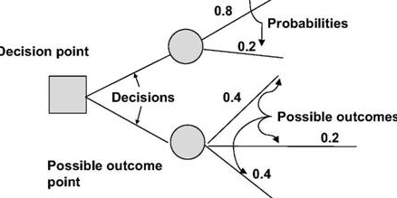
Introduction
Decision trees is a scientific model that is used in the process of decision making. In this presentation we are going to use this model to analyse a scenario which will involve three investments.. In this scenario we are going to make decision based on the experts and the other decision based on our intuition.

Slide 3
Investment options
Option A:Real estate development; high/ favourable :$7.5 million , probability of 0.5. the unfavourable payoff is $2 million with a probability of 0.5
Option B: Just Hat retail franchise; has a payoff of 4.5million with a probability of 0.75 and unfavourable payoff of $2.5 million and a probability of 0.25
Option C:High yield municipal bonds which are low with a single outcome of $1 million and a probability of 1

Slide 4

Analysis
I considered the one two investment options, the real estate and the just huts
With the use of with the use of probabilities and simple decision tree add-on I was able to come up with a best decision tree.

Slide 5
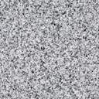
Probability used to start the decision tree
Option A: real estate | Option B: Just hats | Option C: bonds
Favourable probability=0.5 | Favourable probability =0.75
Unfavourable probability=0.5 | Unfavourable probability 0.25

Slide 6

This scenario also look at the scenario where the expert advise is needed of offer more information on the investments.
Posterior Probabilities of Market States
Expert's Prediction Real Estate Just Hats
Prob. Prediction F U F U
0.45 says "F/F" 0.750 0.250 0.900 0.100
0.15 says "F/U" 0.750 0.250 0.300 0.700
0.30 says "U/F" 0.125 0.875 0.900 0.100
0.10 says "U/U" 0.125 0.875 0.300 0.700

Slide 7

The probabilities were used to calculate and fill other methods in the decision tree. Filling all the probabilities in the decision tree would help us know the expected NPV using the expert prediction.

Slide 8

Real Estate expected NPV
F/F 0.45 3375400 1515750
F/U 0.15 1125000 503250
U/F 0.3 605000 215000
U/U 0.1 205000 71000
$2315000

Slide 9
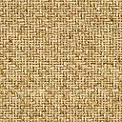
Hats expected NPV
F/F 0.45 2025100 1365875
F/U 0.15 375000 67625
U/F 0.3 1450000 911250
U/U 0.1 250000 43750
$2487500

Slide 10
recommendation
The expert probabilities recommended that Hat merchandise was the best investment because it had the highest Npv than the real estate. It had an NPV of $2487500

Slide 11
Since the probability of the bond was one the expected net value remained the same at a value of $2250000

Slide 12
thank you

